Slide 1
Assignment
Project Problem

Slide 2
Problem Statement
Nitin works as a Graphic Designer in a new company. He earns Rs 15,000/- per month. He is planning to buy a scooter for his daily commute to the office.
For the last couple of months, Nitin is not able to save at all for his scooter. His friend Ayush told him that he needed to figure out where most of the money goes and cut down that expense.
Help Nitin increase his savings by removing some unnecessary expenses.

Slide 3
PART 1

Slide 4
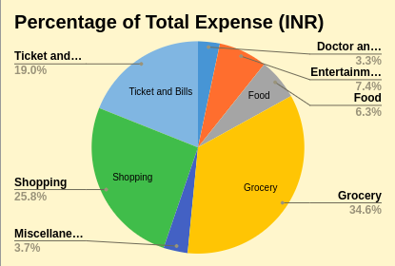
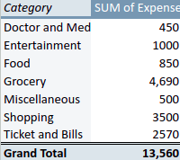
Task 1
How much is spent for each category (pivot Table)
Visually represent the amount spent against each category is what percentage of the total expense amount (Pivot Chart)

Slide 5
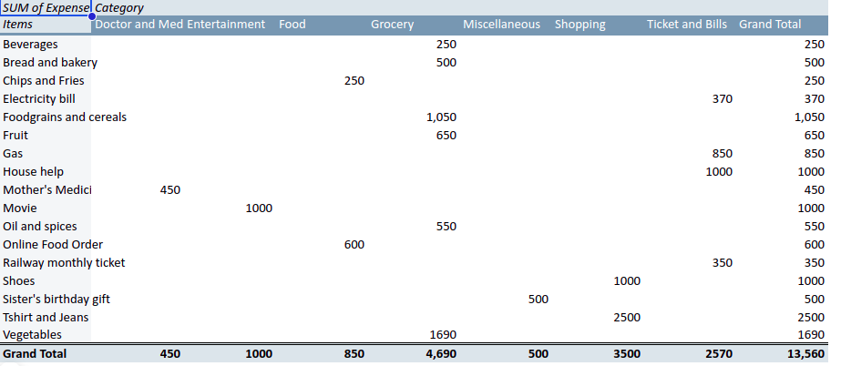
Task 2.1
How much is spent on different items of each category (Pivot Table)

Slide 6
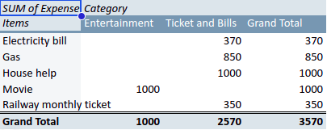
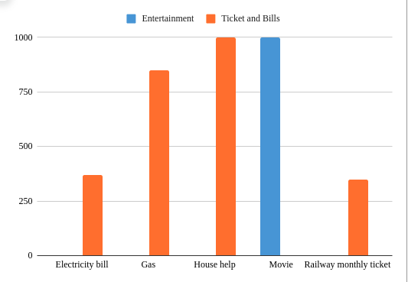
Task 2.2
Visually represent the amount spent on different items of Entertainment and Tickets and bills category (Pivot Chart)

Slide 7
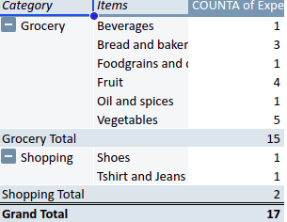
Task 3
How many times money has been spent against different items of each category (Pivot Table)

Slide 8
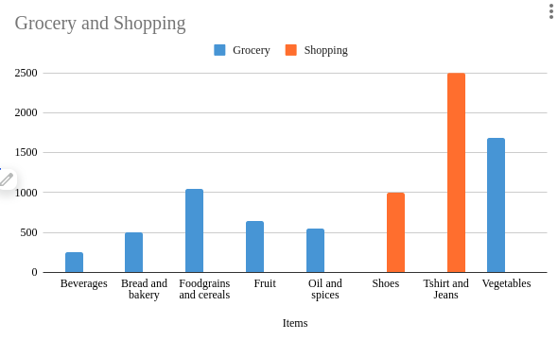
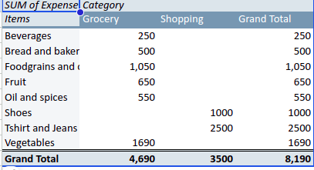
Task 4
What amount is spent on each item of the categories with highest and 2nd highest expense amount (Pivot Table)
Visually represent the data with data bars (Conditional formatting)

Slide 9
PART 2

Slide 10
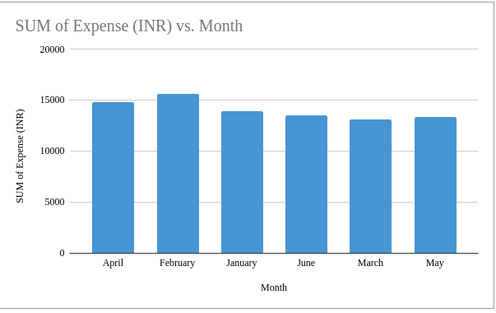
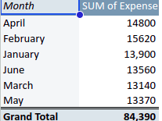
Task 1
Month-wise trend of expenses (Pivot table and chart)
Q. Find out the month Nitin spent the most
A. In the month of February, Nitin spent most

Slide 11
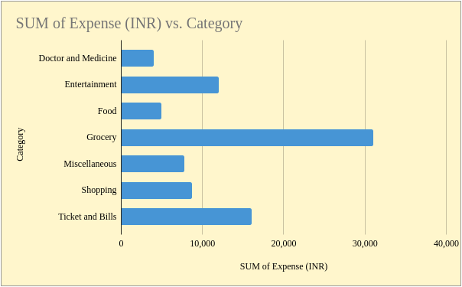
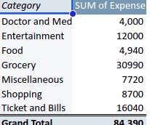
Task 2
Category wise expenses (Pivot table)
Visually represent it with data bars to display categories with the highest and lowest expense amount

Slide 12
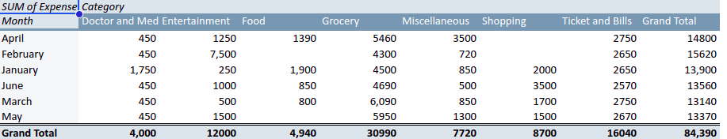
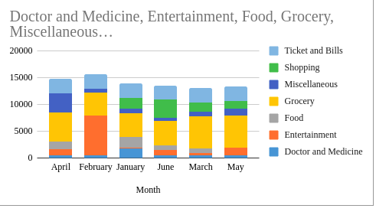
Task 3
Month-wise expense of each category (Pivot table)
Find out 2 categories with higher expenses for each of the 6 months

Slide 13
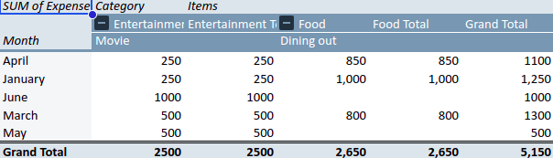
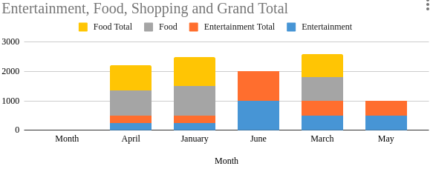
Task 4
How much is spent in each month against different items of Entertainment, Food and Shopping categories (Pivot table)
Find out which months have the highest amount spent for movies and dining out

Slide 14
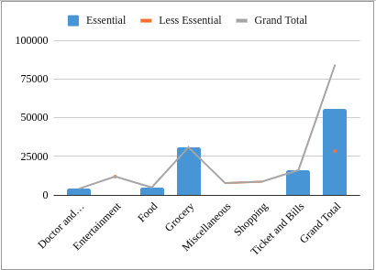
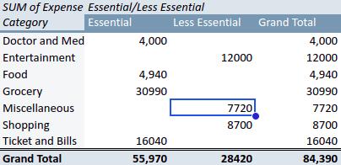
Task 5.1
Decide on the essential and less essential items and analyse the expenses

Slide 15
Task 5.2
Recommend how can Nitin increase his savings
1.Analysis
Entertainment
Current Spending: ₹12,000
Recommendation: Reduce outings and movie expenses. Consider more affordable entertainment options like streaming services or free community events.
Food
Current Spending: ₹4,940
Recommendation: Reduce dining out and online food orders. Cook more meals at home and plan meals to reduce wastage.
Miscellaneous
Current Spending: ₹7,720
Recommendation: Review miscellaneous expenses and cut down on non-essential purchases. Set a monthly budget for these expenses and stick to it.
Shopping
Current Spending: ₹8,700
Recommendation: Limit shopping for clothes and accessories. Buy only when necessary and look for discounts or sales.

Slide 16
Grocery
Current Spending: ₹30,990
Recommendation: Buy in bulk where possible and look for deals on essential items. Plan weekly grocery shopping lists to avoid impulse purchases.
Ticket and Bills
Current Spending: ₹16,040
Recommendation: Review utility bills and identify ways to reduce consumption (e.g., energy-efficient appliances, turning off lights when not in use). Look for cheaper transportation alternatives.
2.Set a Savings Goal
Define Clear Goals: Set a specific amount to save each month and track progress. This creates a target to aim for and helps in making more informed spending decisions.
3.Create a Budget
Monthly Budget: Create a detailed monthly budget that includes all income and expenses. Allocate a specific amount to each category and stick to the budget.

